Slide 1
Software Engineering
A Presentation by:
Arelia Nalle Kharjana
Roll no. 12
Group 5
Date: 19th of June, 2017

Slide 2
Contents
Advanced Topics In Software Engineering
Cleanroom Testing
Software Reuse
Management Issues
The Reuse Process
References

Slide 3
Cleanroom Testing
The goal of cleanroom testing is to validate software requirements by demonstrating that a statistical sample of use-cases have been executed successfully.
Statistical Use Testing
The user of a computer program rarely needs to understand the technical details of the design. The user-visible behavior of the program is driven by inputs and events that are often produced by the user.
But in complex systems, the possible spectrum of input and events (i.e., the use-cases) can be extremely wide.

Slide 4
Cleanroom Testing
What subset of use-cases will adequately verify the behavior of the program? This is the first question addressed by statistical use testing.
Statistical use testing “amounts to testing software the way users intend to use it”.
To accomplish this, cleanroom testing teams (also called certification teams) must determine a usage probability distribution for the software.
The specification (black box) for each increment of the software is analyzed to define a set of stimuli (inputs or events) that cause the software to change its behavior.

Slide 5
Cleanroom Testing
Based on interviews with potential users, the creation of usage scenarios, and a general understanding of the application domain, a probability of use is assigned to each stimuli.
Test cases are generated for each stimuli according to the usage probability distribution. To illustrate this, consider the SafeHome security system.
Cleanroom software engineering is being used to develop a software increment that manages user interaction with the security system keypad.
Five stimuli have been identified for this increment. Analysis indicates the percent probability distribution of each stimulus.

Slide 6
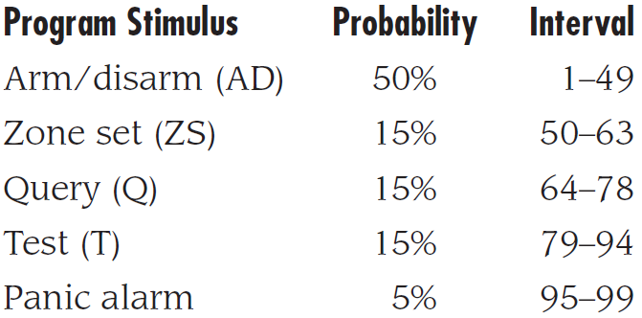
Cleanroom Testing
To make selection of test cases easier, these probabilities are mapped into intervals numbered between 1 and 99 and illustrated in the table:
To generate a sequence of usage test cases that conform to the usage probability distribution, a series of random numbers between 1 and 99 is generated.
The random number corresponds to an interval on the preceding probability distribution. Hence, the sequence of usage test cases is defined randomly but corresponds to the appropriate probability of stimuli occurrence.

Slide 7
Cleanroom Testing
For example, assume the following random number sequences are generated:
13-94-22-24-45-56
81-19-31-69-45-9
38-21-52-84-86-4
Selecting the appropriate stimuli based on the distribution interval shown in the table, the following use-cases are derived:
AD–T–AD–AD–AD–ZS
T–AD–AD–AD–Q–AD–AD
AD–AD–ZS–T–T–AD

Slide 8
Cleanroom Testing
The testing team executes these use-cases and verifies software behavior against the specification for the system.
Timing for tests is recorded so that interval times may be determined. Using interval times, the certification team can compute mean-time-to-failure (MTTF).
If a long sequence of tests is conducted without failure, the MTTF is low and software reliability may be assumed high.

Slide 9
Cleanroom Testing
Certification
The verification and testing techniques will lead to software components (and entire increments) that can be certified.
Within the context of the cleanroom software engineering approach, certification implies that the reliability (measured by mean-time-to-failure, MTTF) can be specified for each component.
The potential impact of certifiable software components goes far beyond a single cleanroom project.

Slide 10
Cleanroom Testing
Reusable software components can be stored along with their usage scenarios, program stimuli, and probability distributions.
Each component would have a certified reliability under the usage scenario and testing regime described.
This information is invaluable to others who intend to use the components.
The certification approach involves five steps:
Usage scenarios must be created.
A usage profile is specified.

Slide 11
Cleanroom Testing
Test cases are generated from the profile.
Tests are executed and failure data are recorded and analyzed.
Reliability is computed and certified.
Certification for cleanroom software engineering requires the creation of three models:
Sampling model. Software testing executes m random test cases and is certified if no failures or a specified numbers of failures occur. The value of m is derived mathematically to ensure that required reliability is achieved.

Slide 12
Cleanroom Testing
Component model. A system composed of n components is to be certified. The component model enables the analyst to determine the probability that component i will fail prior to completion.
Certification model. The overall reliability of the system is projected and certified.
At the completion of statistical use testing, the certification team has the information required to deliver software that has a certified MTTF computed using each of these models.

Slide 13
Software Reuse: Management Isuues
Component-based software engineering (CBSE) is a process that emphasizes the design and construction of computer-based systems using reusable software “components.”
A number of questions arise.
Is it possible to construct complex systems by assembling them from a catalog of reusable software components?
Can this be accomplished in a cost- and time-effective manner?
Can appropriate incentives be established to encourage software engineers to reuse rather than reinvent?

Slide 14
Software Reuse: Management Isuues
Is management willing to incur the added expense associated with creating reusable software components?
Can the library of components necessary to accomplish reuse be created in a way that makes it accessible to those who need it?
Can components that do exist be found by those who need them?
Even today, software engineers grapple with these and other questions about software components reuse.

Slide 15
Software Reuse: Management Isuues
On the surface, CBSE seems quite similar to conventional or object-oriented software engineering.
The process begins when a software team establishes requirements for the system to be built using conventional requirements elicitation techniques.
An architectural design is established, but rather than moving immediately into more detailed design tasks, the team examines requirements to determine what subset is directly amenable to composition, rather than construction.
That is, the team asks the following questions for each system requirement:

Slide 16
Software Reuse: Management Isuues
Are commercial off-the-shelf (COTS) components available to implement the requirement?
Are internally developed reusable components available to implement the requirement?
Are the interfaces for available components compatible within the architecture of the system to be built?
The team may attempt to modify or remove those system requirements that cannot be implemented with COTS or in-house components.

Slide 17
Software Reuse: Management Isuues
If the requirement(s) cannot be changed or deleted, conventional or object-oriented software engineering methods are applied to develop those new components that must be engineered to meet the requirement(s).
But for those requirements that are addressed with available components, a different set of software engineering activities commences:
Component qualification. Component qualification ensures that a candidate component will perform the function required, will properly fit into the architecture style specified for the system, and will exhibit the quality characteristics (e.g., performance, reliability, usability) that are required for the application.

Slide 18
Software Reuse: Management Isuues
Component adaptation. In some cases, existing reusable components may be mismatched to the architecture’s design rules. These components must be adapted to meet the needs of the architecture or discarded and replaced by other, more suitable components.
Component composition. The component composition task assembles qualified, adapted, and engineered components to populate the architecture established for an application.
Component update. When systems are implemented with COTS components, update is complicated by the imposition of a third party (i.e., the organization that developed the reusable component may be outside the immediate control of the software engineering organization).

Slide 19
Software Reuse: Management Isuues
For a definitive description of the term component, Brown and Wallnau suggest the following possibilities:
Component—a nontrivial, nearly independent, and replaceable part of a system that fulfils a clear function in the context of a well-defined architecture.
Run-time software component—a dynamic bindable package of one or more programs managed as a unit and accessed through documented interfaces that can be discovered in run time.

Slide 20
Software Reuse: Management Isuues
Software component—a unit of composition with contractually specified and explicit context dependencies only.
Business component—the software implementation of an “autonomous” business concept or business process.
In addition to these descriptions, software components can also be characterized based on their use in the CBSE process. In addition to COTS components, the CBSE process yields:
Qualified components—assessed by software engineers to ensure that not only functionality, but performance, reliability, usability, and other quality factors conform to the requirements of the system or product to be built.

Slide 21
Software Reuse: Management Isuues
Adapted components—adapted to modify (also called mask or wrap) unwanted or undesirable characteristics.
Assembled components—integrated into an architectural style and interconnected with an appropriate infrastructure that allows the components to be coordinated and managed effectively.
Updated components—replacing existing software as new versions of components become available.

Slide 22
Software Reuse: The Reuse Process
The CBSE Process
The CBSE process, must be characterized in a manner that not only identifies candidate components but also qualifies each component’s interface, adapts components to remove architectural mismatches, assembles components into a selected architectural style, and updates components as requirements for the system change.

Slide 23
Software Reuse: The Reuse Process
The process model for component-based software engineering emphasizes parallel tracks in which domain engineering occurs concurrently with component-based development.
Domain engineering performs the work required to establish a set of software components that can be reused by the software engineer.
These components are then transported across a “boundary” that separates domain engineering from component-based development.
Figure 1 illustrates a typical process model that explicitly accommodates CBSE.

Slide 24
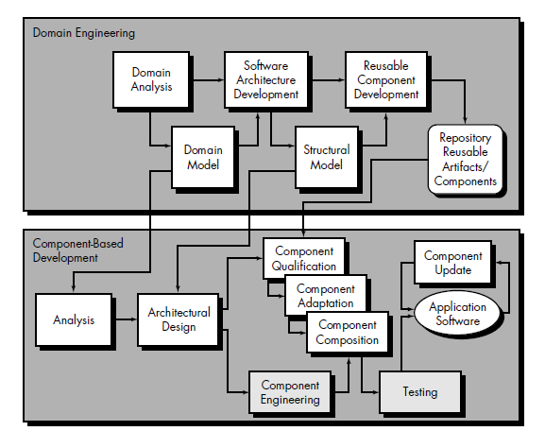
FIGURE 1: A process
model that
supports CBSE

Slide 25
Software Reuse: The Reuse Process
Domain engineering creates a model of the application domain that is used as a basis for analyzing user requirements in the software engineering flow.
A generic software architecture provide input for the design of the application.
Finally, after reusable components have been purchased, selected from existing libraries, or constructed (as part of domain engineering), they are made available to software engineers during component-based development.

Slide 26
Software Reuse: The Reuse Process
The analysis and architectural design steps defined as part of component-based development can be implemented within the context of an abstract design paradigm (ADP).
An ADP implies that the overall model of the software – represented as data, function, and behavior (control) – can be decomposed hierarchically.
As decomposition begins, the system is represented as a collection of architectural frameworks, each composed of one or more design patterns.

Slide 27
Software Reuse: The Reuse Process
Further refinement identifies the component that are required to create each design pattern.
In an ideal context, all of these components would be acquired from a repository (component qualification, adaptation and composition activities aplly).
When specialized components are required, component engineering is applied.

Slide 28
References
Software Engineering A Practitioner’s Approach (Sixth Edition)
Pressman, R. S.

Slide 29
THANK YOU

